Slide 1

Welcome to Data Science Online Bootcamp
Week#5_Day#2

Slide 2

Learning Objectives
Difference between Classification and Regression
Regression Algorithms & Model Evaluation Metrics
Which evaluation metrics to use when?

Slide 3
Disclaimer
We haven’t taught all the algorithms as the Bootcamp was of 5 weeks and we wanted learners to have a good grasp on the concepts that are being taught and not overwhelm them with all the concepts available. Once you know how to handle data and build models, you can easily build different kinds of models.
Through this module, we’ll be providing material around some of the popular algorithms. In addition, we will sharing some more resources soon.

Slide 4
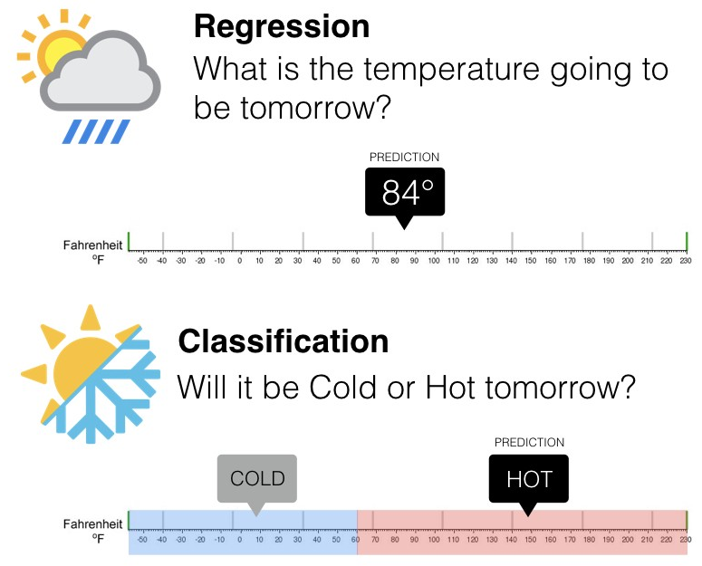
Classification vs Regression
In order to decide whether to use a regression or classification model, the first questions you should ask yourself is:
Does your target variable have a continuous value or is it discrete (binary or multi-class)?

Slide 5
Regression
If your answer is continuous values, you’re dealing with Regression.
This means that if you’re trying to predict quantities like height, income, price, or scores, you should be using a model that will output a continuous number.
So if your objective is to determine tomorrow’s temperature (or let’s stock price tomorrow), you should use a regression model.

Slide 6
Classification
Let’s come to the second case where if you can clearly see that the target variable is divided into classes. You’ll be using Classification here.
When the number of classes is 2, it is known as Binary Classification.
Eg. Will it be hot or cold tomorrow is a binary classification problem with 2 classes: Hot and Cold.
When it is more than 2, it is known as Multi Class Classification.
Eg. Classifying movies in Good, Average or Bad according to reviews.

Slide 7
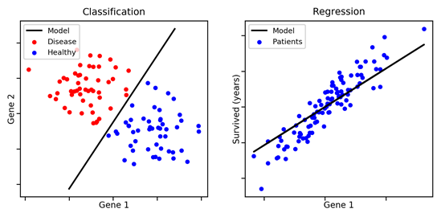
Classification vs Regression
It’s important to understand the characteristics of your target variable before you begin running models and forming predictions.

Slide 8
Regression Algorithms

Slide 9
Types of Regression Algorithms
Linear Regression
Decision Trees (DecisionTreeRegressor)
Random Forest (RandomForestRegressor)
Other Algorithms
Polynomial Regression
Lasso, Ridge and Elastic Net Regression
Support Vector Regressor
And many more….

Slide 10
Linear Regression
Linear regression is a linear model i.e. a model that assumes a linear relationship (straight-line relationship) between the input variables (x) and the single output variable (y). Below are some useful resources that would help you with Linear Regression
Linear Regression Module:
https://docs.google.com/presentation/d/1Vhgfhjc3Ye90wjgy_RPt-G2ModxN1O9EI4kfOa2SS0M/edit#slide=id.p1
Beginners guide to Linear Regression in Python:
https://dphi.tech/a-beginners-guide-to-linear-regression-in-python-with-scikit-learn/
Simple linear Regression implementation in sklearn: https://www.youtube.com/watch?v=b0L47BeklTE

Slide 11
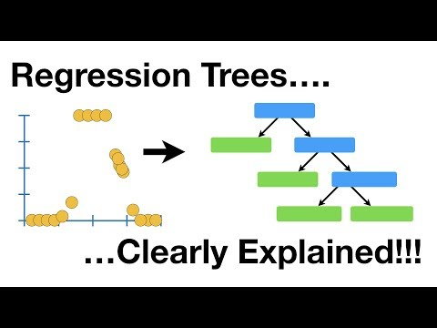
2. Decision Trees for Regression -Regression Trees

Slide 12
Decision Trees
Regression tree analysis is used when the predicted outcome can be considered a real number (e.g. the price of a house, or a patient's length of stay in a hospital).
Note: Something that we didn’t address earlier, Decision Trees are called as Classification And Regression Trees (CART).
Reason: They can be used in both a regression and a classification context. For this reason they are sometimes also referred to as Classification And Regression Trees (CART).
Module on Decision Trees:
https://docs.google.com/presentation/d/1BCwLdFQqFLHR2-7APyoWh5u1b6Jo3wq17nj-8s2H_mg/edit#slide=id.p1

Slide 13
Resources on Decision Tree Regressor
Implementation of Decision Tree Regression: https://heartbeat.fritz.ai/implementing-regression-using-a-decision-tree-and-scikit-learn-ac98552b43d7

Slide 14
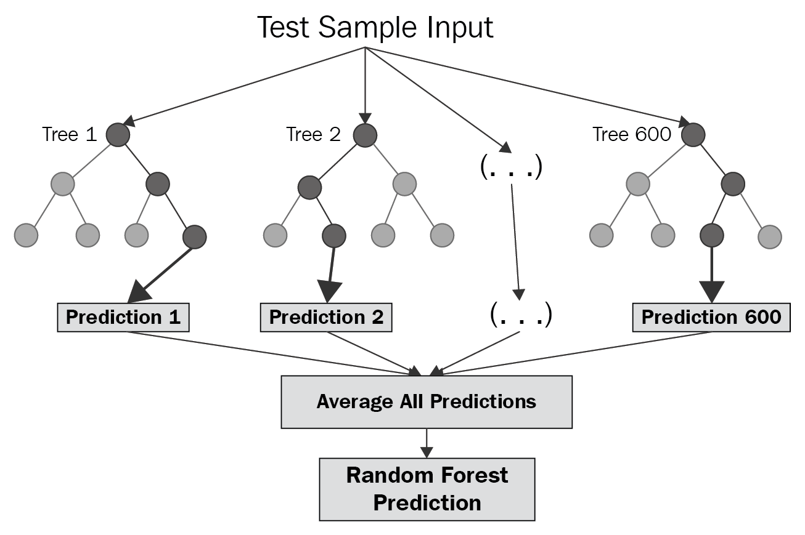
3. Random Forest for regression - Regression Forest
Random forest builds multiple decision trees and merges them together to get a more accurate and stable prediction.
Module for Random Forest and Ensemble Models:
Regression Forests (or Random forest Regressors) are an ensemble (combination) of different regression trees (decision trees for regression). Each leaf contains a distribution for the continuous output variable/s.

Slide 15
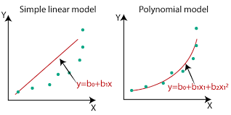
Other Regression Algorithms
POLYNOMIAL REGRESSION:
Polynomial Regression is a form of linear regression in which the relationship between the independent variable X and dependent variable y is not linear (cannot be represented by a straight line).
Which of the following do you think is a better fitted line for the green data points?
The second one. The only difference is that instead of using the equation of a straight line, we are using a different equation of higher order polynomial.
Learn more about Polynomial Regression:
https://towardsdatascience.com/polynomial-regression-bbe8b9d97491

Slide 16
Other Regression Algorithms
2. LASSO, RIDGE AND ELASTIC NET REGRESSION:
There are extensions of the linear regression model training called as regularization methods. They aim to minimize the error, while keeping the complexity of the model low.
Two popular examples of regularization procedures for linear regression are:
Lasso Regression (called L1 regularization).
Ridge Regression: (called L2 regularization).
These methods are effective to use when there is collinearity in your input variables and there’s a chance of overfitting the training data.

Slide 17
Other Regression Algorithms
There is another commonly used model of regression called Elastic Net. It incorporates penalties from both L1 and L2 regularization.
You can read more about Lasso, Ridge and Elastic Net Regression here:
https://hackernoon.com/an-introduction-to-ridge-lasso-and-elastic-net-regression-cca60b4b934f

Slide 18
Other Regression Algorithms
3. SUPPORT VECTOR REGRESSOR (SVR)
Support Vector Machines (SVMs) are well known in classification problems. However, the use of SVMs in regression is not as well documented. These types of models are known as Support Vector Regression (SVR).
SVR gives us the flexibility to define how much error is acceptable in our model and will find an appropriate line to fit the data.
SVR Tutorial:
https://www.analyticsvidhya.com/blog/2020/03/support-vector-regression-tutorial-for-machine-learning/

Slide 19
MUST READ
Regression Algorithms and their applications:
https://analyticsindiamag.com/top-6-regression-algorithms-used-data-mining-applications-industry/#:~:text=Today%2C%20regression%20models%20have%20many,lasso%20regression%20and%20multivariate%20regression.
https://www.analyticsvidhya.com/blog/2015/08/comprehensive-guide-regression/

Slide 20
Evaluating a Regression Model

Slide 21
Regression Model Evaluation
Cost function
What is predicted and expected/true value?
Evaluation Metrics
RMSE
MAE
MSE

Slide 22
Cost Function
What?
Now that we built a model, we need to measure its performance right? and understand if it works well or not. Cost function measures the performance of a Machine Learning model for given data. It quantifies the error between predicted values and expected values and presents it in the form of a single real number.
Depending on the problem Cost Function can be formed in many different ways. The purpose of this function is to be either:
Minimized - then returned value is usually called cost, loss or error. The goal is to find the values of model parameters for which Cost Function return as small number as possible.
Maximized - then the value it yields is named a reward. The goal is to find values of model parameters for which returned number is as large as possible.

Slide 23
What is predicted and expected value?
Predicted value: As the name says is the predicted value of your machine learning model.
Expected/Actual value: Is the true value(or the label present in your data)
Often machine learning models are not 100% accurate or perfect, then tend to deviate from the true value or expected value.
Explaining with an example: If we are predicting the age of a person based on few input variables or features.
Our machine learning model predicted the age as 28 years
However, the actual age of the person is 29 years.
Here 28 years is predicted value and 29 years is expected value or true value. As data scientists, we try to minimize the error while building models.

Slide 24
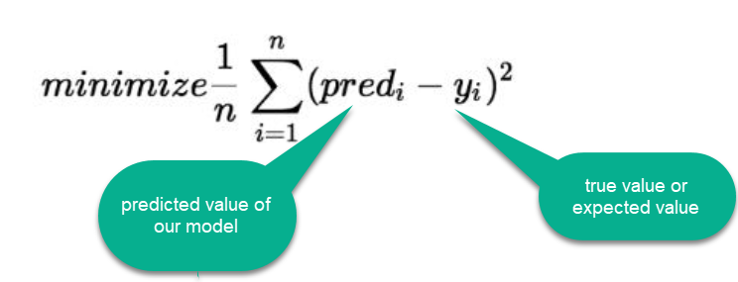
Cost Function
The difference between the true value and the model’s predicted value is called residual.

Slide 25
Cost Function Types/ Evaluation Metrics
There are three primary metrics used to evaluate linear models (to find how well a model is performing):
Mean Squared Error:
Root Mean Squared Error
Mean Absolute Error

Slide 26
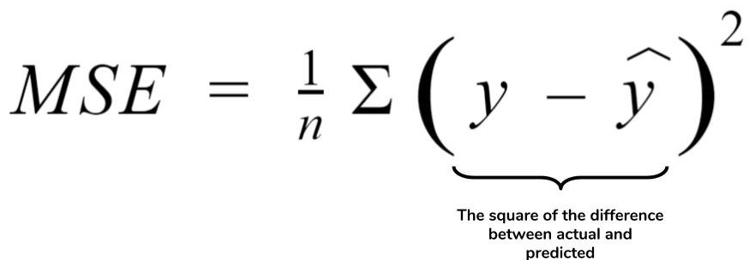
Mean Squared Error (MSE)
MSE is simply the average of the squared difference between the true target value and the value predicted by the regression model.
As it squares the differences, it penalizes (gives some penalty or weight for deviating from the objective) even a small error which leads to over-estimation of how bad the model is.

Slide 27
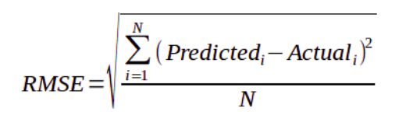
Root Mean Squared Error (RMSE)
It is just the square root of the mean square error.
It is preferred more in some cases because the errors are first squared before averaging which poses a high penalty on large errors. This implies that RMSE is useful when large errors are undesired.

Slide 28
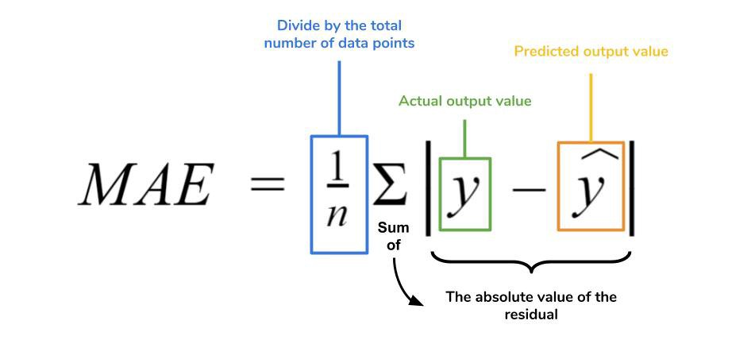
Mean Absolute Error(MAE)
MAE is the absolute difference between the target value and the value predicted by the model.
MAE does not penalize the errors as effectively as mse making it not suitable for use-cases where you want to pay more attention to the outliers.

Slide 29
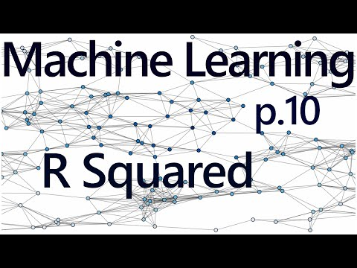
R Squared ( Coefficient of determination)

Slide 30
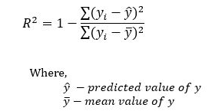
R Squared ( Coefficient of determination)
R-squared is a goodness-of-fit measure for linear regression models.
It represents the coefficient of how well the values fit compared to the original values. The values from 0 to 1 are interpreted as percentages.
The higher the value is, the better the model is.
Going by the name, you might think R2 cannot be negative. However, it can. A Negative R2 means you are doing worse than the mean value.

Slide 31
Which metrics to use when?

Slide 32
Which metrics to use when?
This is an important question and we get used to learning these measures over time. Sharing some resources with you all so that it helps you understand what metrics to be used in the context of solving a regression problem.
https://medium.com/usf-msds/choosing-the-right-metric-for-machine-learning-models-part-1-a99d7d7414e4 (you may ignore “Bonus” section in the article for time being)

Slide 33
Slide Download Link
You can download the slides here:
https://docs.google.com/presentation/d/1pswRt_u83cXD8M5ub5Dd766g8BL14UEs02EbdikWfWc/edit?usp=sharing

Slide 34
That’s it for the day. Thank you!
Feel free to post any queries in the #help channel on Slack

